Slide 1
Landslide Prediction
Frontier Tech Leaders Programme Global Cohort 1
Selam Habtewold
Finhas Demissie
Bealu Girma
01/10/2024

Slide 2
How to use this template
Frontier Tech Leaders Programme Global Cohort 1
Download the file
Change the name into "Name_Surname_Draft_Presentation"
Do not move the text boxes, keep your text and visuals inside the boxes
Do not change the colors and font type
If you need to change the font size make it consistent and don't use different sizes in one page (biggest 28, smallest 16). Titles always should be 44.
You can duplicate a page if you need more than one pages
Add high quality pictures and their sources. Keep it inside the boxes.
Key color - #2B2551​
Supporting color 1 - #FFC837 ​
Supporting color 2 - #4CA3AA ​
Supporting color 3 - #FFFFFF​
Supporting color 4 - #FF577D
Remove this page before uploading the presentation to your Github repository!

Slide 3
Outline
Frontier Tech Leaders Programme Global Cohort 1
Concept note and implementation plan:
Background
Objectives
SDG Relation
Data
Data Collection
Exploratory Data Analysis (EDA) and Feature Engineering
Model Selection and Training
Model Evaluation and Hyperparameter Tuning
Model Refinement and Testing
Results
Deployment
Future Work

Slide 4
Concept note and implementation plan
Frontier Tech Leaders Programme Global Cohort 1

Slide 5
Background
Frontier Tech Leaders Programme Global Cohort 1
Landslides occur due to the downward movement of soil, rock, and debris, triggered by factors like heavy rainfall, earthquakes, volcanic activity, and human activities such as deforestation. They can lead to loss of life, infrastructure damage, and environmental harm, particularly in mountainous areas.
Traditional landslide prediction methods using geological surveys are slow and resource-heavy. Machine learning (ML) now offers a faster approach by analyzing large datasets of environmental and geological factors to predict landslides more effectively.
Landslide prediction impact:
Saving lives: Early warnings allow for timely evacuations, reducing the risk to human life.
Protecting infrastructure: Identifying high-risk zones helps in designing infrastructure that can withstand or avoid landslide-prone areas.
Reducing economic loss: Mitigating landslides prevents damage to property, roads, and agricultural land, thereby reducing financial loss.
Improving land management: Predictions can guide policymakers and developers to implement sustainable land-use practices in landslide-prone regions.

Slide 6
Objectives
Frontier Tech Leaders Programme Global Cohort 1
Accurate Prediction: Develop a machine learning model to predict landslides using environmental, geological, and meteorological data.
Risk Zoning: Identify high-risk areas for better land-use planning.
Accessible Platform: Deploy the model on a user-friendly web platform for easy access by authorities and planners.

Slide 7
SDG Relation
Frontier Tech Leaders Programme Global Cohort 1
SDG 9: Industry, Innovation, and Infrastructure Using machine learning for landslide prediction promotes innovation in disaster risk reduction and infrastructure resilience.
SDG 11: Sustainable Cities and Communities The project helps build resilient cities by predicting landslides, enabling better planning, and reducing disaster risks.
SDG 13: Climate Action By mitigating climate-related disasters, it addresses the growing threat of landslides due to climate change.
SDG 15: Life on Land The project protects ecosystems by preventing landslide-induced environmental damage.

Slide 8
Data
Frontier Tech Leaders Programme Global Cohort 1

Slide 9
Data Collection
Frontier Tech Leaders Programme Global Cohort 1
Dataset Source: The dataset used for this project was obtained from Kaggle
Features Collected:
Aspect Curvature, Earthquake Activity, Elevation, Flow Accumulation, Lithology (Rock/Soil Type), NDVI (Vegetation Index), NDWI (Water Index), Plan Curvature, Precipitation, Profile Curvature and Slope (Terrain Steepness)

Slide 10
Data Collection
Frontier Tech Leaders Programme Global Cohort 1
Preprocessing Steps during Data Collection
Data Cleaning:
Removal of Duplicate Records
Outlier Detection
Handling Missing Values:
Missing values were filled using appropriate methods such as: Mean/Median or Mode.
Scaling Features:
Min-Max Scaling is applied to continuous features to normalize the data

Slide 11
Exploratory Data Analysis (EDA) and Feature Engineering
Frontier Tech Leaders Programme Global Cohort 1
EDA Process:
Purpose: Identify data patterns, detect anomalies, and understand relationships.
Techniques:
Histograms: Analyzed distributions of features like elevation, precipitation, and slope.
Box Plots: Detected outliers in features like precipitation and NDVI.
Correlation Heatmap: Identified strong correlations between features such as precipitation, slope, and elevation with landslide risks.

Slide 12
Exploratory Data Analysis (EDA) and Feature Engineering
Frontier Tech Leaders Programme Global Cohort 1
Feature Engineering:
Feature Creation:
Slope × Precipitation: Captured interaction between steep terrains and rainfall.
Vegetation-Water Index (NDVI × NDWI): Assessed soil stability and moisture levels.
Feature Transformation:
Binning: Simplified continuous variables like elevation and precipitation into categories.
Interaction Features: Combined aspect and slope to analyze drainage and erosion impact.

Slide 13
Exploratory Data Analysis (EDA) and Feature Engineering
Frontier Tech Leaders Programme Global Cohort 1
Scaling, Normalization, and Encoding:
Min-Max Scaling: Applied to elevation, precipitation, slope, and NDVI to normalize data between 0 and 1.
Log Transformation: Reduced skewness for features like precipitation and earthquake.
Label Encoding: Categorical features like lithology were numerically encoded.

Slide 14
Exploratory Data Analysis (EDA) and Feature Engineering
Frontier Tech Leaders Programme Global Cohort 1
Rationale:
Interaction Features: Higher slopes and rainfall increase landslide risk.
Vegetation and Water: NDVI and NDWI assess the stability of soil, affecting landslide probability.
Elevation Binning: Grouped elevation levels to model non-linear relationships with landslides.

Slide 15
Model
Frontier Tech Leaders Programme Global Cohort 1

Slide 16
Model Selection and Training
Frontier Tech Leaders Programme Global Cohort 1
Rationale for Model Selection:
Chosen Models:
Random Forest: Robust, handles high-dimensional data, reduces overfitting through averaging.
Gradient Boosting: Strong predictor, optimizes performance by focusing on errors.
Decision Tree: Simple and interpretable model, good for initial insights.
SVM: Effective for high-dimensional spaces, suitable for non-linear decision boundaries.
Logistic Regression: Useful as a baseline classifier, easy to interpret.

Slide 17
Model Selection and Training
Frontier Tech Leaders Programme Global Cohort 1
Strengths and Weaknesses:
Random Forest:
Strengths: High accuracy, handles missing data well, prevents overfitting.
Weaknesses: Harder to interpret due to ensemble structure.
Gradient Boosting:
Strengths: Great for reducing bias, captures complex patterns.
Weaknesses: Slower to train, sensitive to noisy data.

Slide 18
Model Selection and Training
Frontier Tech Leaders Programme Global Cohort 1
Decision Tree:
Strengths: Easy to visualize, fast to compute.
Weaknesses: Prone to overfitting, less accurate without ensemble techniques.
SVM:
Strengths: Effective in complex, non-linear datasets, strong generalization.
Weaknesses: Computationally expensive, sensitive to choice of kernel and parameters.
Logistic Regression:
Strengths: Simple, interpretable, provides probability estimates.
Weaknesses: Assumes linear relationships, weaker in capturing complex patterns..

Slide 19
Model Selection and Training
Frontier Tech Leaders Programme Global Cohort 1
Training the Model:
Training Process: Split dataset into 80% training, 20% testing. Each model was trained using:
Cross-validation: 5-fold cross-validation used to minimize overfitting and evaluate model performance.

Slide 20
Model Selection and Training
Frontier Tech Leaders Programme Global Cohort 1
Model Performance Overview:
Model | Accuracy | F1-Score | Precision | Recall
Gradient Boosting | 0.7942 | 0.7807 | 0.7236 | 0.8476
Random Forest | 0.7819 | 0.7665 | 0.7131 | 0.8286
SVM | 0.7737 | 0.7639 | 0.6953 | 0.8476
Logistic Regression | 0.7243 | 0.7243 | 0.6377 | 0.8381
KNN | 0.7160 | 0.7206 | 0.6268 | 0.8476

Slide 21
Model Selection and Training
Frontier Tech Leaders Programme Global Cohort 1
Gradient Boosting Chosen:
Accuracy: 79.42%
F1-Score: 78.07%
Precision: 72.36%
Recall: 84.76%
Rationale: Chosen for its superior balance between accuracy, precision, and recall.

Slide 22
Model Evaluation and Hyperparameter Tuning
Frontier Tech Leaders Programme Global Cohort 1
Evaluation Metrics:
Accuracy: Measures the percentage of correct predictions.
F1-Score: Balances precision and recall, useful when data is imbalanced.
Precision: Indicates how many predicted positive cases were actually positive.
Recall: Measures how many actual positive cases were correctly identified.

Slide 23
Model Evaluation and Hyperparameter Tuning
Frontier Tech Leaders Programme Global Cohort 1
Hyperparameter Tuning:
Gradient Boosting Hyperparameters Tuned:
Learning Rate: Controlled the step size during training, improved model accuracy.
Number of Estimators: Increased from default to find an optimal number of trees.
Max Depth: Adjusted to control tree depth, helped in reducing overfitting.

Slide 24
Model Refinement and Testing
Frontier Tech Leaders Programme Global Cohort 1
Refinement Process: Significantly improved model performance through iterative tuning and validation.
Final Model: Gradient Boosting proved to be the most reliable model after testing.
Testing Results: Consistently high accuracy and recall, showing the model's effectiveness in predicting landslide risks.

Slide 25
Results
Frontier Tech Leaders Programme Global Cohort 1

Slide 26
Evaluation Results
Frontier Tech Leaders Programme Global Cohort 1
Logistic Regression:
Best accuracy: 0.7523
Tuned Accuracy: 0.7284 Random Forest:
Best accuracy: 0.7926
Tuned Accuracy: 0.7819

Slide 27
Evaluation Results
Support Vector Machine (SVM):
Best accuracy: 0.7915
Tuned Accuracy: 0.7737 Gradient Boosting:
Best accuracy: 0.7942
Tuned Accuracy: 0.78

Slide 28
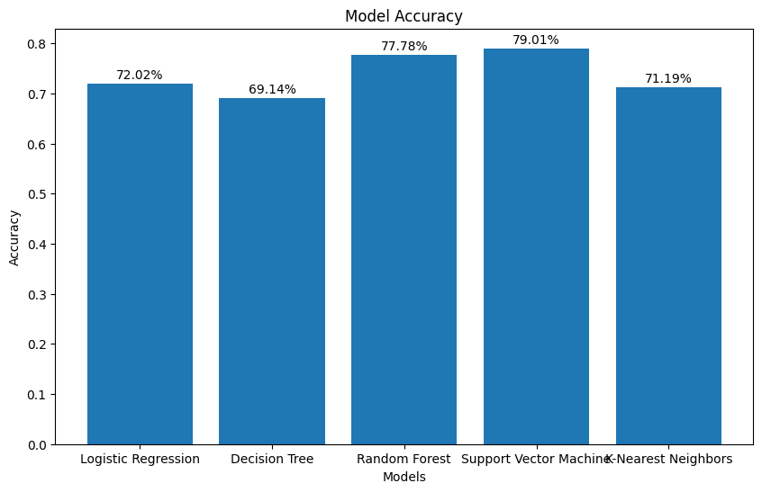
Evaluation Results
K-Nearest Neighbors (KNN):
Best accuracy: 0.7709
Tuned Accuracy: 0.7037

Slide 29
Deployment
Frontier Tech Leaders Programme Global Cohort 1
Frontend: Flask was used to create a user-friendly front end that allows users to interact with the model seamlessly. Through this interface, users can input data directly into the application and receive predictions without needing to handle the model’s technical details.
Backend Integration: The machine learning model was integrated into the Flask application as part of the backend. Once users submit input data through the front end, the backend processes the data, runs the model, and returns the predicted outcomes.

Slide 30
Future Work
Frontier Tech Leaders Programme Global Cohort 1
Model Optimization and Feature Engineering: Continue to optimize the model by exploring more advanced algorithms (such as deep learning) and improving feature selection. Adding more environmental and geological features could improve predictive power.
Risk Zoning and Mapping: Extend the model's functionality to include automated risk zoning and mapping. This could help authorities visualize high-risk areas, aiding in land-use planning and the design of resilient infrastructure.
Scalability and Regional Customization: Adapt the model to predict landslides in different geographical regions, taking into account varying environmental factors. Customizing the model for local conditions would increase its usefulness across different regions.

Slide 31
Future Work
Mobile Application for Wider Accessibility: Build a mobile application to complement the web platform, allowing authorities and the public to receive timely alerts and access predictions on the go. This would make the platform more accessible in remote and high-risk areas.
Collaboration with Government and Environmental Agencies: Work closely with government agencies, environmental organizations, and disaster management teams to incorporation the model into official disaster risk reduction strategies. Collaborations would ensure the model's data is used for life-saving decisions.

Slide 32



Thank you!
Frontier Tech Leaders Programme Global Cohort 1

